Slide 1
MLOps People
Università di Modena e Reggio Emilia
Prof. Nicola Bicocchi (nicola.bicocchi@unimore.it)

Slide 2
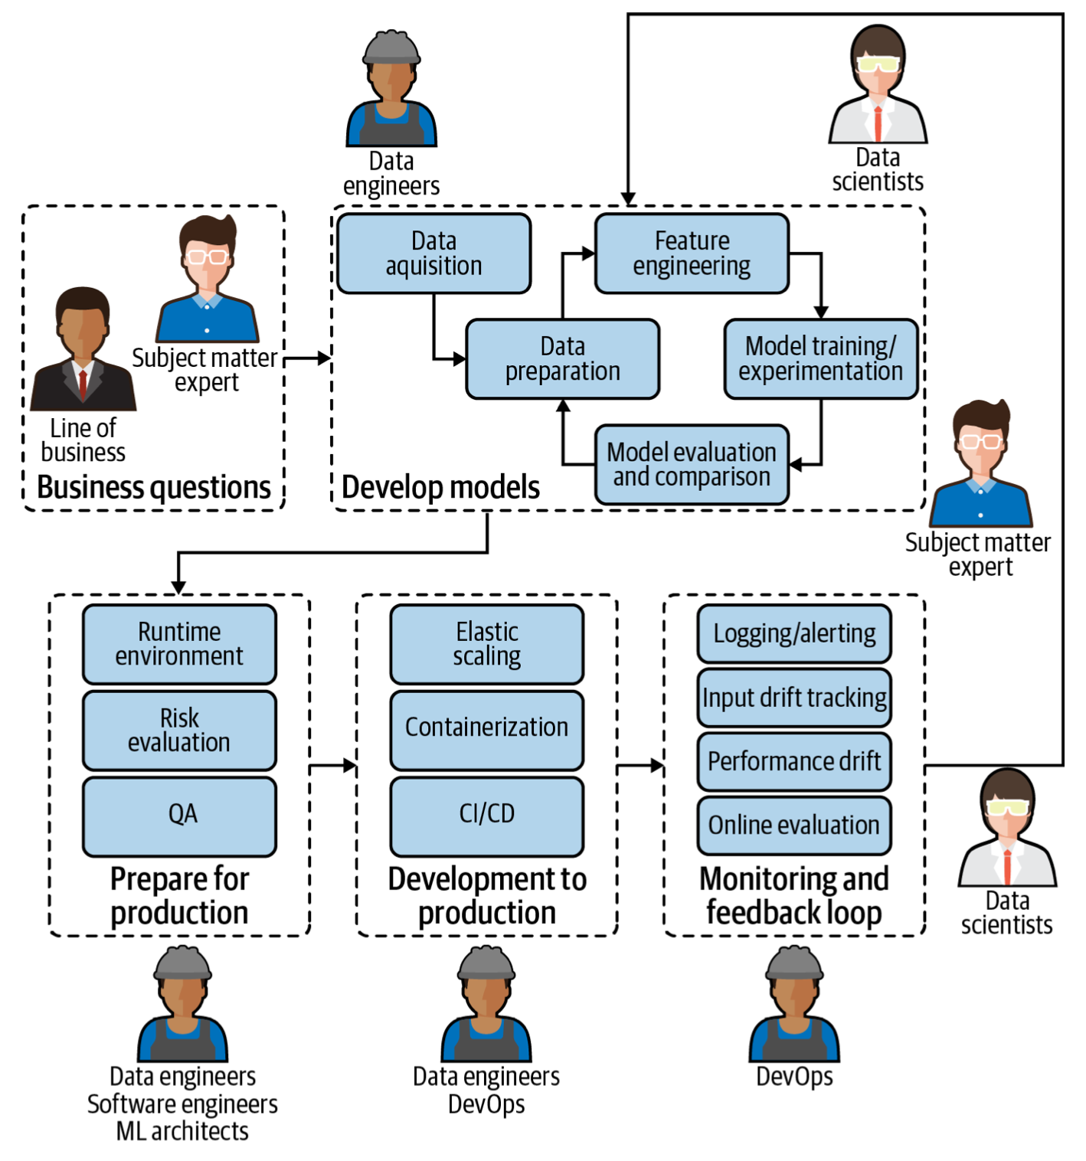
People
MLOps isn’t just for data scientists; a diverse group of experts across the organization has a role.
Each person from the subject matter expert on the business side to the most technical machine learning architect plays a critical part in the maintenance of ML models in production.
This is ultimately important not only to ensure the best possible results from ML models (good results generally lead to more trust in ML-based systems as well as an increased budget to build more), but also to protect the business from risk.

Slide 3
Subject matter experts
Role in machine learning model life cycle
Provide business questions, goals, or KPIs around which ML models should be framed.
Continually evaluate and ensure that model performance aligns with or resolves the initial need.
MLOps requirements
Easy way to understand deployed model performance in business terms.
Mechanism or feedback loop for flagging model results that don’t align with business expectations.

Slide 4
Data scientists
Role in machine learning model life cycle
Build models that address the business question or needs brought by subject matter experts.
Deliver operationalizable models so that they can be properly used in the production environment and with production data.
Assess model quality (of both original and tests) in tandem with subject matter experts to ensure they answer initial business questions or needs.
MLOps requirements
Automated model packaging and delivery for quick and easy (yet safe) deployment to production.
Ability to develop tests to determine the quality of deployed models and to make continual improvements.
Visibility into the performance of all deployed models (including side-by-side for tests) from one central location.
Ability to investigate data pipelines of each model to make quick assessments and adjustments regardless of who originally built the model.

Slide 5
Software engineers
Role in machine learning model life cycle
Optimize the retrieval and use of data to power ML models.
MLOps requirements
Visibility into performance of all deployed models.
Ability to see the full details of individual data pipelines to address underlying data plumbing issues.

Slide 6
DevOps
Role in machine learning model life cycle
Conduct and build operational systems and test for security, performance, availability.
Continuous Integration/Continuous Delivery (CI/CD) pipeline management.
MLOps requirements
Seamless integration of MLOps into the larger DevOps strategy of the enterprise.
Seamless deployment pipeline.

Slide 7
Data engineers
Role in machine learning model life cycle
Integrate ML models in the company’s applications and systems.
Ensure that ML models work seamlessly with other non-machine-learning-based applications.
MLOps requirements
Versioning and automatic tests.
The ability to work in parallel on the same application.

Slide 8
Model risk managers/auditors
Role in machine learning model life cycle
Minimize overall risk to the company as a result of ML models in production.
Ensure compliance with internal and external requirements before pushing ML models to production.
MLOps requirements
Robust, likely automated, reporting tools on all models (currently or ever in production), including data lineage.

Slide 9
Machine learning architects
Role in machine learning model life cycle
Ensure a scalable and flexible environment for ML model pipelines, from design to development and monitoring.
Introduce new technologies when appropriate that improve ML model performance in production.
MLOps requirements
High-level overview of models and their resources consumed.
Ability to drill down into data pipelines to assess and adjust infrastructure needs.

